Slide 1
Role of UNDP’s SDGCCs Vehicles of change

Slide 2
Sustainable Development Goals
17 Sustainable Development Goals (SDGCCs)169 targets
Premised on promoting social, economic and environmental targets to achieve sustainable development
Addressing poverty, hunger, inequality, climate change concerns,
environmental degradation, unrest and injustice
Adopted by 193 United Nations Member States in 2015

Slide 3
SDG Structure of Implementation
UN agencies, technical support for dashboards,
peer learning
04 01
National level: NITI Aayog Sub-national level: Planning departments
PARTNERSHIPS
LEADERSHIP
National level: SDG India Index and dashboard, National Indicator Framework Sub-national level: State and District Indicator Frameworks, dashboards
MONITORING
INSTITUTIONAL
MECHANISMS
National level: NITI Aayog, MoSPI Sub-national level: Nodal departments, dedicated units, district-level structures,
03 02
high-level reviews

Slide 4
THE SUSTAINABLE DEVELOPMENT GOALS
1
COORDINATION CENTRES IN INDIA
Strong institutional set-ups, new capacities and ways of working in coordination with all stakeholders are essential for the implementation of the SDGs. The institutional set-ups should be able to:
Create interlinkages and synergies
Develop strong monitoring systems
SDGs play a crucial role in making institutions more transparent, accountable and supports participatory decision-making processes.
Assist state governments in
Ensure coordination
integrated policymaking
among all stakeholders
INSTITUTIONAL SET-UP

Slide 5
Increased mobilization & empowering public institutions contribute to the effective implementation of the 2030 Agenda.
Considering the above factors UNDP proposed the state governments to
develop Sustainable Development Goals Coordination Centre (SDGCC)
The SDGCC is a special planning vehicle embedded in the departments of Planning, Economics and Statistics and the finance departments of different states.
The centres ensures effective governance and convergence among departments and stakeholders in order to achieve the SDGs.

Slide 6
SDGCCs IN INDIA
SDGCCs have currently been established in Haryana, Punjab, Uttarakhand, Nagaland and Karnataka under the partnership of UNDP and state
Within a span of just two years, SDGCCs have become hugely successful in fostering partnerships
governments.
between people and governments in localizing SDGs to states, districts and to some gram panchayats.

Slide 7
FIVE PILLARS OF THE SDGCC: THE STRATEGY FOR THE SDGCCs
The Five pillars of a good strategy for successful SDGCCs are:
1
2
4
5
Communication and capacity building around the SDG vision of the state for realizing its targets
Integrated planning and implementation by proposing innovations
and solutions to accelerate
implementation
of the SDGs
SDG localization by adapting the vision for local-, district- and Gram
Panchayat-level authorities in their respective plans
Resource mobilization & partnership
through plans and systems to mobilize partners and resources to meet the unprecedented need for human, financial and physical resources
Monitoring & evaluation
through sophisticated technology-based tools to monitor progress of the SDG Vision 2030

Slide 8
COMMUNICATION AND CAPACITY BUILDING
1
SDGCC Haryana
CPPGG Uttarakhand
C Capacity Building and Sensitization of Departments
Several workshops and consultations were organized by SDGCC Haryana and CPPGG Uttarakhand to strengthen the capacity of various departments and sensitize them towards SDGs.
CPPGG supported GoUK in organizing a number of workshops with various state and district level officials to sensitize them on SDGs.
State level workshop with Officials of 13 Zila Panchayats and 95 Block Panchayats to integrate the SDGs framework with GPDP
ToT for officials for district level integrating SDGs in District and GP plans
Booklet on SDGs alignment with state and centre sector schemes
Webinars for youth
M&E and capacity building workshop for all departments
Six workshops for all officials of departments on output- outcome indicators and alignment of their schemes to the SDG National Indicator Framework
Consultation meetings with all 53 departments to finalize indicators and develop Output-Outcome Framework Report
Sensitization workshop with department officials on the SDG National Indicator Framework and NITI Aayog’s SDG India Index

Slide 9
SDGCC Karnataka
SDGCC Nagaland
SDG Community Broadcast
Nagaland for Green Christmas Campaign
The SDGCC successfully used Karnataka’s community radios to disseminate information and awareness on various government initiatives and schemes to educate people at the grassroots.
The NGOs registered in the Darpan directory were oriented on the SDGs under the community broadcast programme.
The campaign involved a “Green Christmas Contest”
participants shared photos and videos of any “green Christmas activity” undertaken.
500 participants signed the Green Christmas Pledge to celebrate an eco-friendly Christmas.
SDG4 Youth: Youth Engagement through Academia & Department of Youth Empowerment and Sports
and
Aligning the All India Council for Technical Education (AICTE) outreach programme with the SDGs
Inaugarating India’s first SDG Centre for Youth Engagement > 350 students from this centre were given orientation on the SDGs by the SDGCC.
The contest received 20 entries with four winners

Slide 10
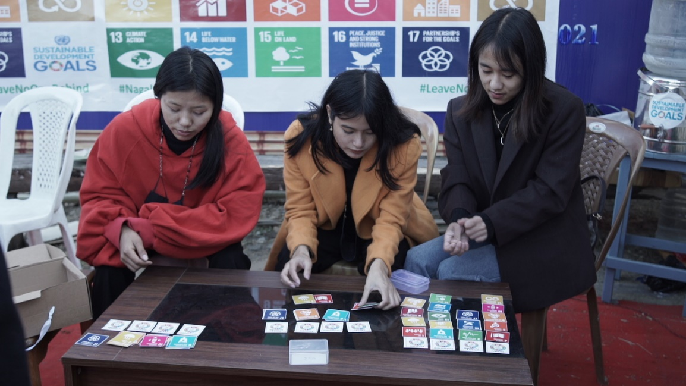
SDGCC Punjab
SDGCC Nagaland
SDG One Stop Destination, Hornbill Festival 2021
Building SDG Action Awards
To create public awareness on SDGs, an exclusive SDG Stall was established in Hornbill Fest by Planning Department and SDGCC Nagaland. SDG Games, posters, SDG Quizzes ,karaoke live sessions were held
To promote the efforts of all change-makers from government, NGOs, corporate businesses and academia/ individuals who provide innovative solutions to the state’s development issues and SDGs
Session on SDGs with 6 universities reaching out to 800 students & faculty

Slide 11
Posters for
departments
Communication and Outreach
Films
SDG anthem
Exhibition panels
Several innovative tools
have been created to
communicate about SDGs
for various stakeholders.
Multiple level online SDG quiz
SDG Innovation Participatory Action Research Initiative
Social media handles on Facebook and Instagram
A dedicated website showcasing SDGCC Haryana project milestones: www.sdgcc.in

Slide 12
INTEGRATED PLANNING AND
2
IMPLEMENTATION
Vision Plans at State and District level
State and District level workshops with officials
District Action Plans- District 4SAP for all 20 districts of Punjab
SDG Budgeting
SDG Budget Allocation Report (2019-20, 2020-21, 2021-22,2022-23)Tool for departments to make informed decisions about rationalized resource allocations(Haryana)
Output-Outcome Framework Report (2019-20, 2020-21, 2021- 22,2022-23)
Publications for integrated planning
District SDG Localization and Integration Manual(Nagaland)
Best Practices and Innovations Booklet (Punjab, Karnataka)
Aligns the state government’s public spending with development and welfare efforts as per the SDGs(Haryana)
Formulation of State SDG Vision Plan

Slide 13
SDG Localization
3
Creating Awareness
SDG Integration
Monitoring Mechanism
Sensitization on SDGs
Aligning SDGs with District Plan, Block Plan and GPDP
Real time monitoring of the indicators through mobile based application, SDG Model Village to be piloted

Slide 14
SDGCC Haryana
District SDG Profile Booklets
Districts are very important units of governance; their role in achieving 2030 Agenda is very vital
The SDGCC developed the District SDG Profile Booklets for 20 districts of Haryana to support:
Implementation
Facilitate
inter-district resource gap analysis
District-level planning
Monitoring
Help improve inter-
department convergence
within the district
A District Budget Booklet for Aspirational District, Nuh
District budget booklet of aspirational district Nuh was drafted in alignment with the SDGs.

Slide 15
SDGCC Punjab
Upgrade Quality of GPDP Process at the Gram Panchayat Level by Linking the SDGs
SDG-aligned Gram Panchayat Development Plans (GPDPs) are envisioned as a step forward for developing model SDG panchayats through SDG governance and implementation strengthening at the grassroots level.
The SDGCC assisted the Patiala district administration to conduct a needs assessment of five identified gram panchayats by following a participatory approach.
All the panchayat secretaries and representatives from Patiala district administration participated in the meeting.
The needs of the gram
The SDGCC will also support the identified GPs to implement various activities, including necessary training in collaboration with the district administration.
panchayats were assessed at
an individual and collective
level and the meeting ended
with the finalization of priority
activities along with budgetary
requirements and processes
for approval.
Strengthen training institutions to capacitate key officials to localize the SDGs through developing a training manual on developing SDG integrated GPDPs
The SDGCC - in collaboration with the State Institute of Rural Development - developed a training manual for the
panchayats on SDG localization to institutionalize SDG training and integrate the SDGs into development plans

Slide 16
Formation of the District SDG Cell in Patiala, Punjab. Five gram panchayats selected from the district to prepare SDG-aligned gram panchayat development plans (GPDPs)
District SDG Cell Formulated to coordinate different actions and processes required for achieving the SDGs in an inclusive way
They help understand how local governments and district administrations can support the achievement of the SDGs and SDGs can provide a framework for local development policy.
Trained district-level officials for all districts of the state to take forward the SDGs

Slide 17
CPPGG Uttarakhand
Model Panchayat Plan book
A three-tier Model Panchayat Plan book developed to guide the concerned officials on 29 Panchayat subjects and align them with the SDGs
Updated Training Modules
Integration of SDG related session in trainer’s handbook and information on SDGs in training modules of Panchayati Raj Department.
Development of Local Indicator Framework
The LIF development for GPs is under process

Slide 18
SDGCC Nagaland
SDGCC Karnataka
Develop SDG Model Villages
Model GP Clusters
SDGCC Nagaland is working with the Government of Nagaland to develop a SDG Model Village on a pilot basis.
The following activities are planned to create a model village:
Capacity building of implementers: Members of VC and VDB on SDG localisation and integration in the context of a village in Nagaland
Conducting SDG oriented need assessment
Aligning the existing schemes and policies to SDGs
Identifying village specific challenges and their viable solutions
Aligning SDGs with the respective village development plans
UNDP, in partnership with the Department of Rural Development aims to create Model GP Clusters to achieve Holistic and Sustainable Development
Lead to Institutional strengthening of GPs and enablement of Quality GPDP.
The GP Clusters to be provided technical guidance and handholding support to evolve into Model GP Clusters.
UNDP is prototyping a real-time based mobile based application for monitoring impact, outcome and output indicators for tracking the progress of GPs.
The resultant data will be housed in a centralized Dashboard that will be dynamic in nature- enabling real-time data availability

Slide 19
4
Resource Mobilization and
Partnership
Mapping Stakeholders
Platform creation
Innovation
SDG Alignment Reports
Akanksha CSR Portal(Karnataka)
SDG First Networking Platform(Haryana)
Map NGOs, CSRs and academic institutions by Punjab and Haryana
7.1.1. SDG First Networking Platform
GEET-GIS Enabled Entitlement Tracking (Punjab)

Slide 20
Monitoring and Evaluation (M&E)
5
Aatmanirbhar Bharat Tracker
State Indicator Framework & District Indicator Framework
SDG Dashboard
IT enabled dashboards built to monitor SDGs at state and district level
This innovative monitoring dashboard was developed for the use of the state governments of Haryana, Punjab and Karnataka
Timely implementation and real-time monitoring of the economic stimulus package under the Aatmanirbhar Bharat Abhiyan.
SDGCCs assisted State Governments of Haryana, Punjab, Uttarakhand(CPPGG) in the formulation of SIF & DIF
CPPGG has developed a monthly monitoring tool for monitoring 36 indicators for all its districts

Slide 21
THANK YOU

